Slide 1
Containers and Orchestrators
Notes:
Introduction to the Cloud

Slide 2
Overview
Container Images
The Container Lifecycle
Orchestration (Swarm, Kubernetes, etc)
Container Networking
Kubernetes

Slide 3
System calls
System Call
Application
Kernel
Disk
open(" /test.txt", "r")
| Source: Wikipedia/Pdesousa359 under CC BY 3.0

Slide 4
System calls
Application
Disk
open(" /test.txt", "r")
Kernel
open(" /test.txt", "r")
Application
Disk
| Source: Wikipedia/Pdesousa359 under CC BY 3.0

Slide 5
Process Collaboration
Network
Interprocess Communication (IPC)
Signals
etc
| Source: Wikipedia/Pdesousa359 under CC BY 3.0

Slide 6
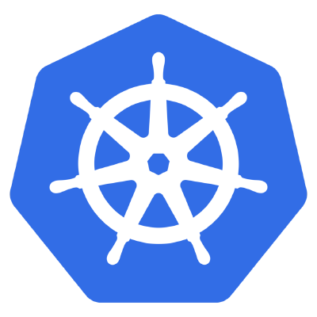

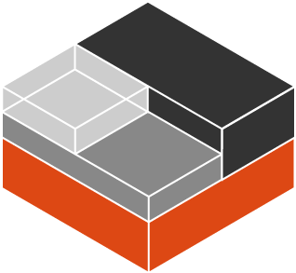
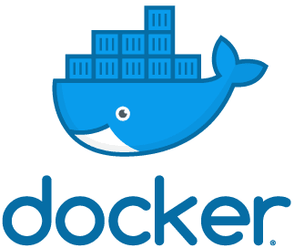
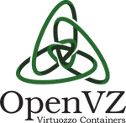


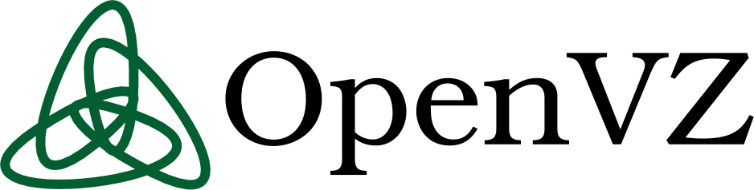



Containers

Slide 7
Containers
Virtual Network Card
Process Separation
Separate Filesystem
Restricted IPC
User separation
| Source: Wikipedia/Pdesousa359 under CC BY 3.0

Slide 8

Container Images
Source: Unsplash/Julius Drost under Unsplash License

Slide 9
Dockerfile
FROM ubuntu:20.04
RUN apt update &&
apt install –y nginx &&
rm /var/lib/apt/lists/*
CMD ["/usr/sbin/nginx","-g","daemon off;"]
| Source: Wikipedia/Pdesousa359 under CC BY 3.0

Slide 10
Dockerfile
FROM ubuntu:20.04
RUN apt update &&
apt install –y nginx &&
rm /var/lib/apt/lists/*
CMD ["/usr/sbin/nginx","-g","daemon off;"]
Difference
Difference
Difference
| Source: Wikipedia/Pdesousa359 under CC BY 3.0

Slide 11

Registry
Version Control System
CI/CD
Container Orchestrator
Application
Runtime
Registry
Worker Node
Container

Slide 12

Container Lifecycle
Source: Unsplash/Matheo JBT under Unsplash License

Slide 13
Immutable Infrastructure
Containers are not updated
They are replaced
Data is persisted with volumes

Slide 14
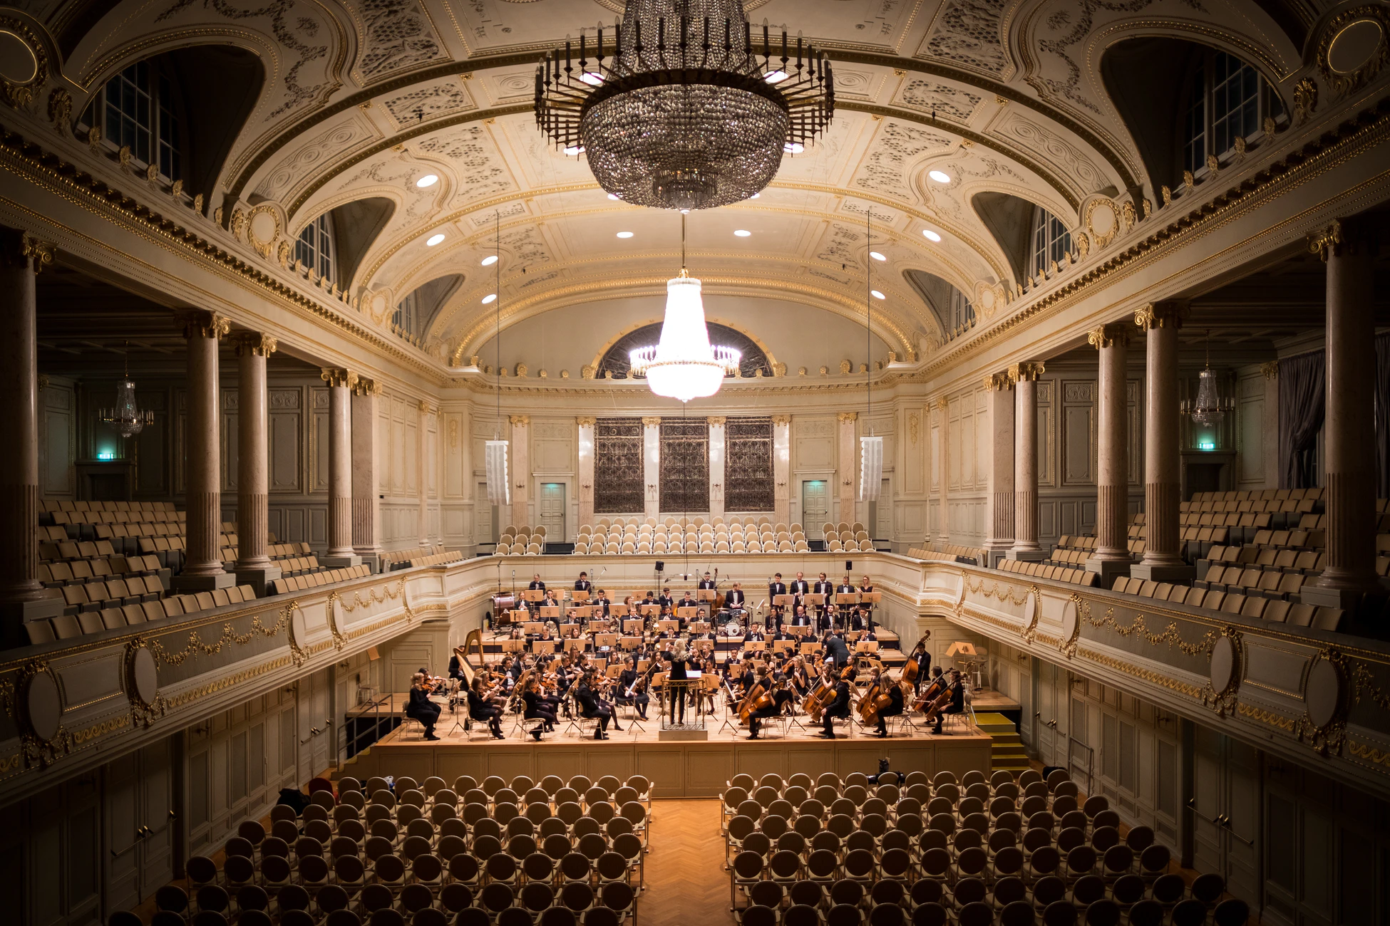
Container Orchestration
Source: Unsplash/Manuel Nägeli under Unsplash License

Slide 15
Orchestration
Container Orchestrator
Worker Node
Worker Node
Worker Node

Slide 16
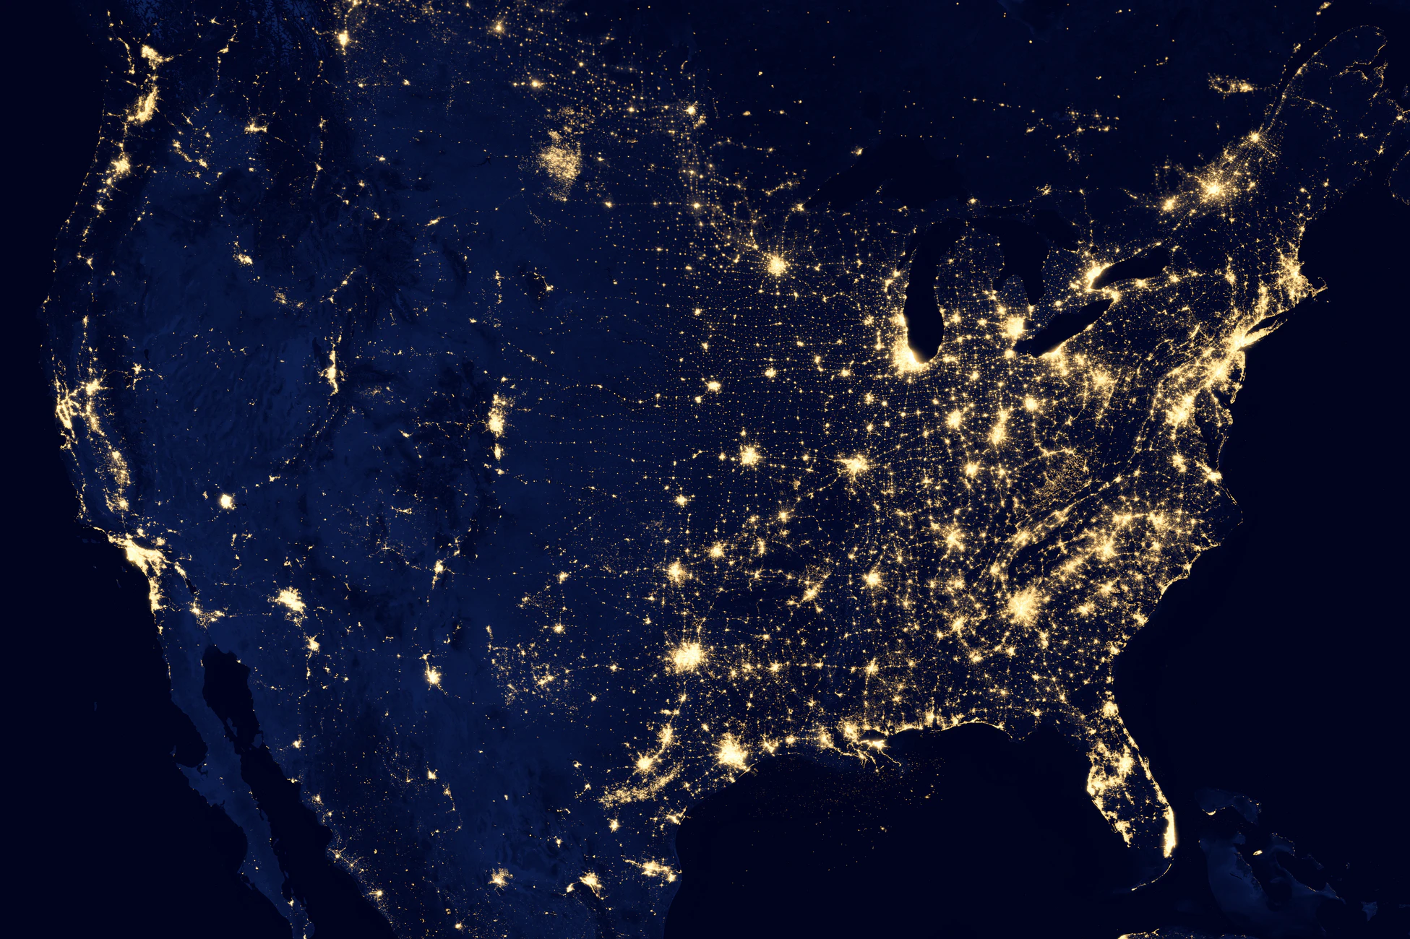
Container Networking
Source: Unsplash/NASA under Unsplash License

Slide 17
Docker Networking
Worker Node
eth0
NAT
docker0 (bridge)
veth0
veth1
veth2
Container
Container
eth0
eth0
eth0
Container

Slide 18
Overlay Networking
Worker Node
Worker Node
Container
Container
Container
Container
Container
Container

Slide 19
Firewalls
Worker Node
Worker Node
Container
Container
Container
Container
Container
Container

Slide 20

Kubernetes
Source: Unsplash/Zoltan Tasi under Unsplash License

Slide 21
Basic Structure
Deployment
ReplicaSet
Pod
Container
Container

Slide 22
StatefulSet
StatefulSet
Pod id=1
Pod id=2
Pod id=3
Container
Container
Container
Container
Container
Container

Slide 23
DaemonSet
DaemonSet
Worker Node
Worker Node
Worker Node
Pod
Pod
Pod
Container
Container
Container
Container
Container
Container

Slide 24
Persistent Volumes
Pod
Container
Container
PersistentVolumeClaim
PersistentVolume

Slide 25
Services
Service app=nginx
Endpoint app=nginx
Endpoint app=nginx
Pod app=nginx
Pod app=nginx
Container
Container
Container
Container

Slide 26
Load Balancers
Load Balancer
Worker Node
Worker Node
Worker Node
Pod
Container
Container

Slide 27
Ingress
Load Balancer
Worker Node
Worker Node
Worker Node
Pod
Ingress Controller
Container
Container
Container
Container

Slide 28
Jobs & CronJobs
Job: Runs once, to completion. Can be retried.
CronJob: Launches Jobs periodically

Slide 29
Architecture
Kubectl
CNI
Master
etcd
database
Controller-Manager
API server
Scheduler
Cloud Controller
Worker Node
Kube-proxy
Kubelet

Slide 30

Thank you!
Source: Unsplash/Wilhelm Gunkel under Unsplash License

